Slide 1
BAKERY MANAGEMENT SYSTEM

Slide 2
ABSTRACT
Here we shared bakery Shop Management System Project Report which is developed using eclipse. This is software application and is used maintain control most of the activities happening in big shop. This maintains and controls the stock details and does billing and generates various reports.
The bakery Shop Management System will allow more than one shop owner, to sell various products less than one roof. “Details of products in the stock with product code, product name, quantity” bakery Shop Management System is inventory software that designed specially to meet the requirements of small and medium sized enterprises, such as bakery stores whole sale or retail. It is easy to create invoice, do inventory control like invoice management, stock balance management, goods item management, goods category management, staff sales records management and staff permission management, backup and restore stock by Inventory’s user friendly and graphical interface and functionalities. And Inventory supports full customizable Company info, tax code and value, invoice number etc.

Slide 3
HARDWARE SPECFICATION
Processor : P 4 700 GHz.
RAM : 4 GB RAM
Hard Disk Drive : 180 GB

Slide 4
SOFTWARE SPECIFICATION
Operating System : Windows 7/8/10
Front End : JAVA
Back End : SQL

Slide 5
EXISTING SYSTEM
Here the shop has been handled by manually, so it’s very hard to managing the bakery shop. Each and every purchase and sales can be handling into the paper and managing it. Here there’s an no records have been provided to the owner or manager. These kinds of issues may be happened in the existing system
Disadvantages
Very hard to find the stock details
No records will be provided by the system

Slide 6
PROPOSED SYSTEM
Here in this system provide lot of features, like purchase, sales and stock details. Once the admin registered these records can be followed by the system. Here we can provide the details in less minute time.
Advantages
We can easily identify the product details in a systematic
Generate billing and stock details in a system way

Slide 7
Modules
Customer Registration
This module will be collecting the all the information about the customer, when customer visit or purchase any product admin has collect the customer details and register here,
Product Registration
This module admin registers the product details, what are the products are available into the bakery shop, once it’s added it will be stored into the product table.
Purchase
When owner purchasing the product for a shop, it should manage by this module. each and every purchase detail are should be managing here, then only we can maintain the stock details.

Slide 8
Sales
This module is act as an when customer purchasing the any product admin collect the purchase details and sales it. Then it will show the total cost rupees in a sales screen.
Stock
This module helps to shown the what are the stocks are available in the shop, we can easily identify the overall stock in the single screen. Also, can able to find the what are the stocks will be close find then can purchase the order.
Billing
This module has to shown the billing details for the bakery shop. We can see the billing detail as a date wise and customer wise. Which can provide the report to the shop
QR Code Generation
This module will be generate QR code, when the owner/admin wants to check the billing details they can scan the code and get the details very securely. We can generate the QR code to all the module and scan the details.

Slide 9

Data Flow Diagram
Level 0:

Slide 10
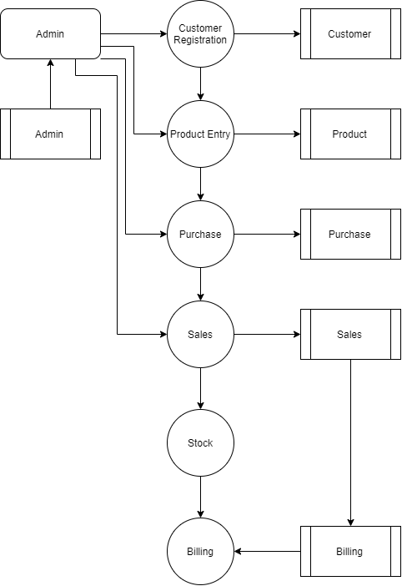
Level 1:

Slide 11
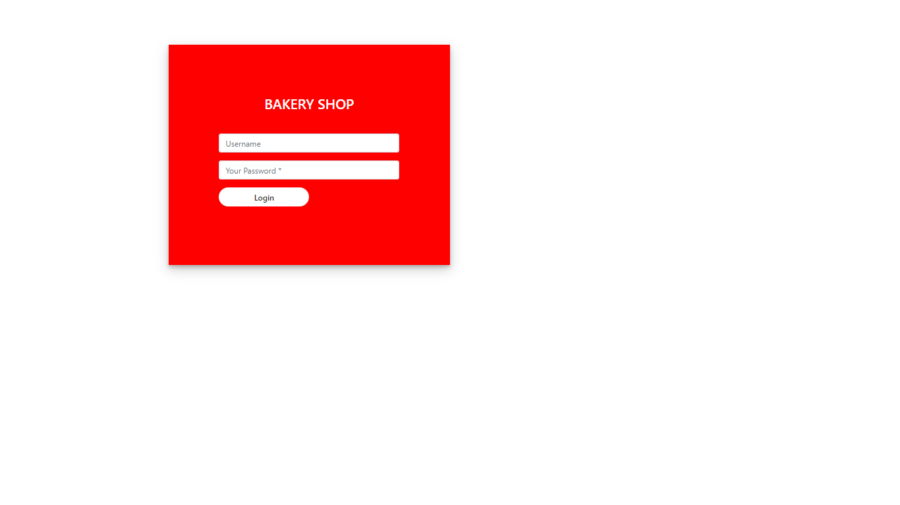

Slide 12
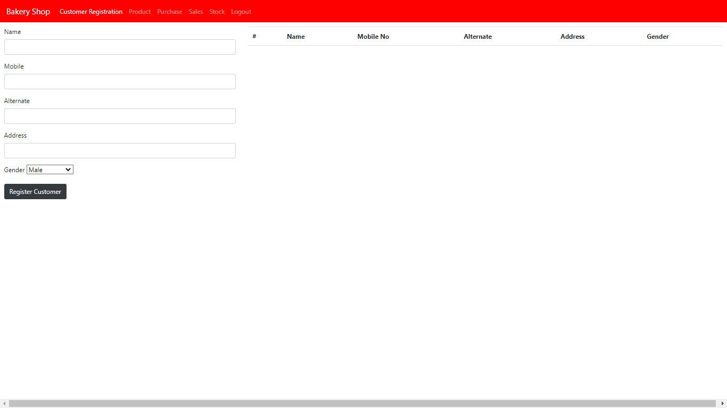

Slide 13
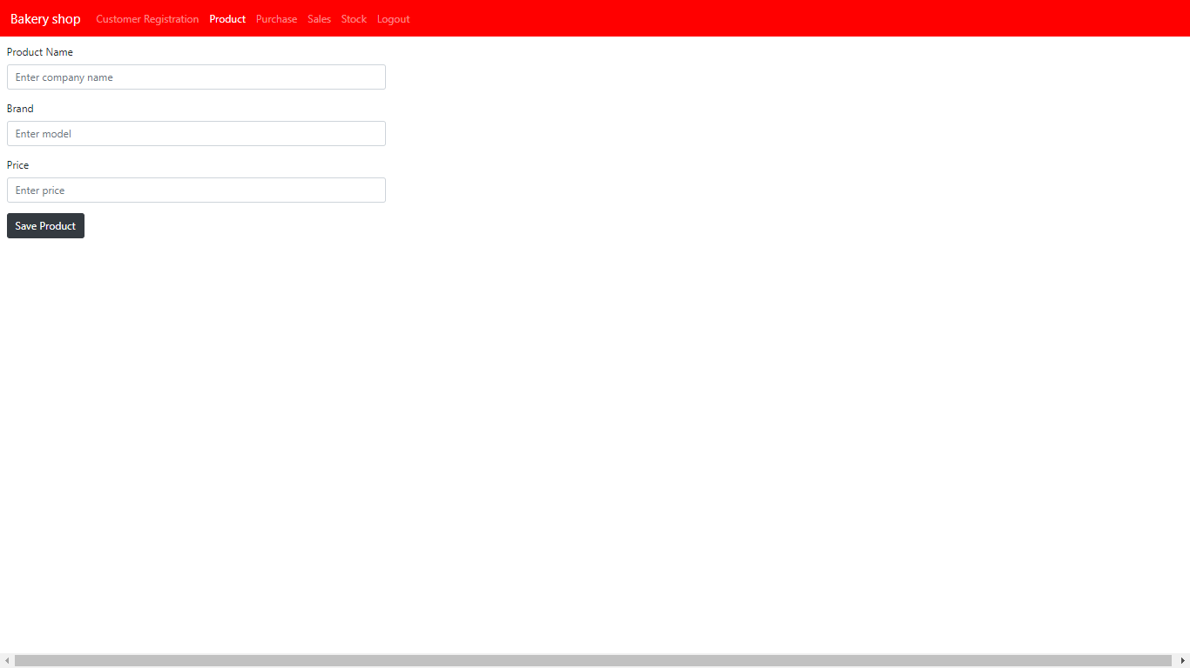

Slide 14
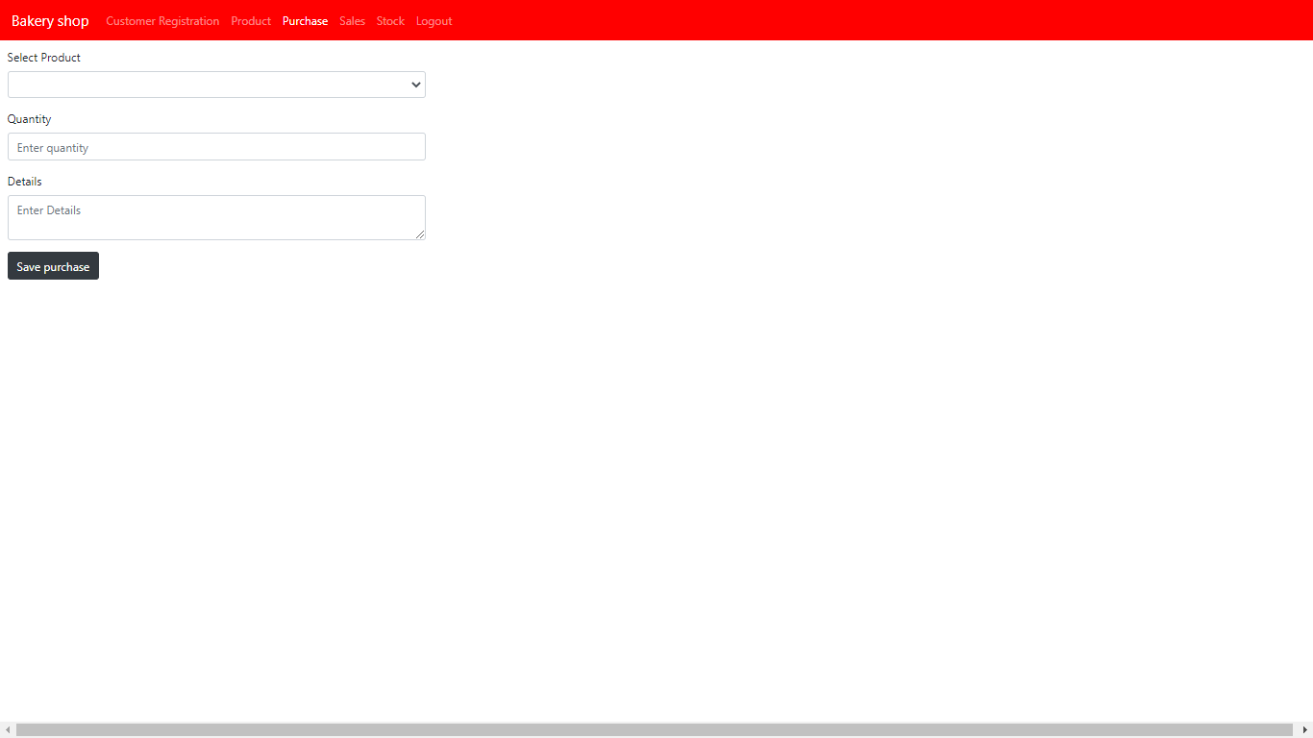

Slide 15
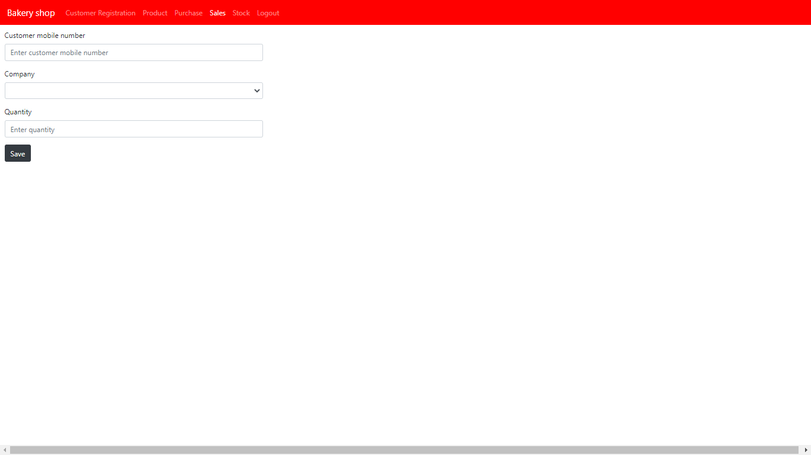

Slide 16
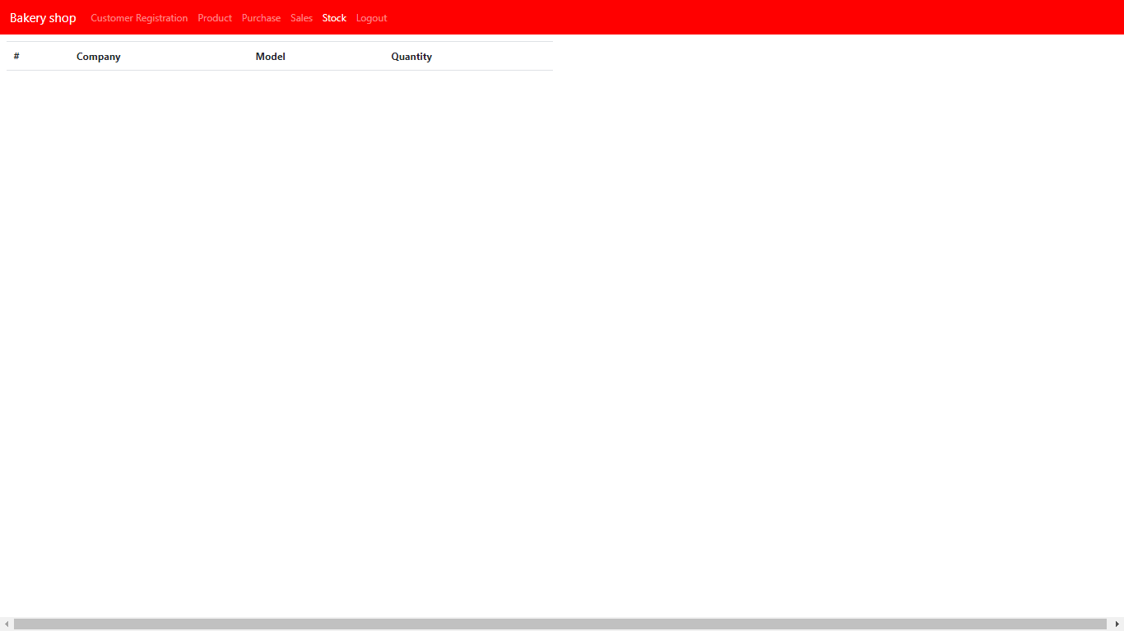

Slide 17
Thank You

